Slide 1
Propositional Logic
Mirko Farina
Assistant Professor
Innopolis University
* I do not claim authorship for all texts and pictures in the presentation.

Slide 2
Summary of Previous Lecture
What is Categorical Logic?
Elements of Categorical Logic
Quantity
Quality
Distribution

Slide 3





Exercises
Rephrase the following statements (When needed)into categorical proposition. Then individuate subject, predicate, copula, and quantifier. Say which type of statement and determine which term (if any) gets distributed
All kittens are adorable
2. Some logic lessons are exciting
3. Some dogs are biters
4. All squirrels are nut-gatherers
5. Atlanta is in Georgia

Slide 4












6. Heights always make me nauseous
7. The mosquitos are everywhere
8. Newborn babies aren’t potty-trained
9. Birds are in the backyard
10. Several toys are still on the floor

Slide 5
TODAY’S PLAN
Propositional Logic
Historical Antecedents
Modern Development
The Basic Unit of Propositional Logic
Connectives (Logical Operators)
How to Individuate the Top Level Operator
Well formed propositions
Translating propositions into propositional logic
Exercises

Slide 6
Historical Antecedents
Stoic philosophy
The Stoics = influential and powerful school of thought
KEY concepts: ataraxia and virtues
KEY Proponents: Zeno, Crisippus, Epictetus, Cato, Seneca, Marcus Aurelio (yes, the Emperor!)

Slide 7
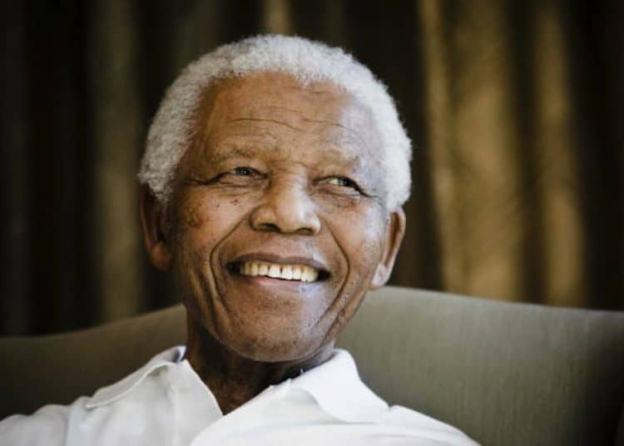
STOIC – someone who remain calm under difficult situations
Yet, the Stoic is not a passive individual –quite the opposite. Person set on a path of self improvement guided by 4 basic virtues:
Wisdom
Temperance
Justice
Courage
Stoicism inspired Mandela during his time in prison!

Slide 8
STOICS: Important Contributions to Logic
Crisippus / Aristotle rivalry
Difference: Stoic logic was based on the analysis of propositions rather than terms

Slide 9
The Fundamental Logical notion (atomic) for the Stoics was not that of term but rather that of Assertible
Assertible: 4 features
Sound uttered;
The actual things to which the sound referred;
Lekton, the sayable was conveyed by the language;
It possesses a truth value at any point in time

Slide 10



Atomic Units (Assertibles: ‘it is night’) can be enriched and expanded via connectives (as in propositional logic as we shall see)
Stoics: 3 connectives
Conditional (if)
Conjunctive (and)
Disjunctive (or)
Modern Propositional Logic we have 5
Stoic logic was largely forgotten (only rediscovered in modern times)

Slide 11
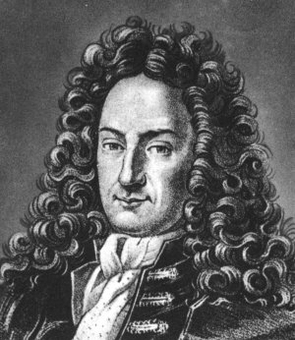
Modern Development : Leibniz
Gottfried Wilhelm Leibniz = philosopher and polymath
Contributions to physics, engineering, philosophy, mathematics, theology, history, law, politics, and philology..
He also discovered the binary number system and created the first calculator

Slide 12
Leibniz was born in Leipzig to prominent parents.
Age 12 = fluent in Latin and Greek
Age 13 = . he was deep into the works of Aristotle and scholastic philosophy,
Age 14 = entered the University of Leipzig,
Age 19 = Offered a professorship.

Slide 13
Leibniz loved a luxurious life… ☺
However, at age 18 he lost his huge inheritance , tricked by his uncle
To satisfy his expensive taste he decided to attach himself to rich people, who would pay for his lectures and intellectual company.
First he worked for the Duke Hannover, then worked for Peter the Great (he is the founder of the Russian Academy of Sciences) and even for Catherine the Great

Slide 14
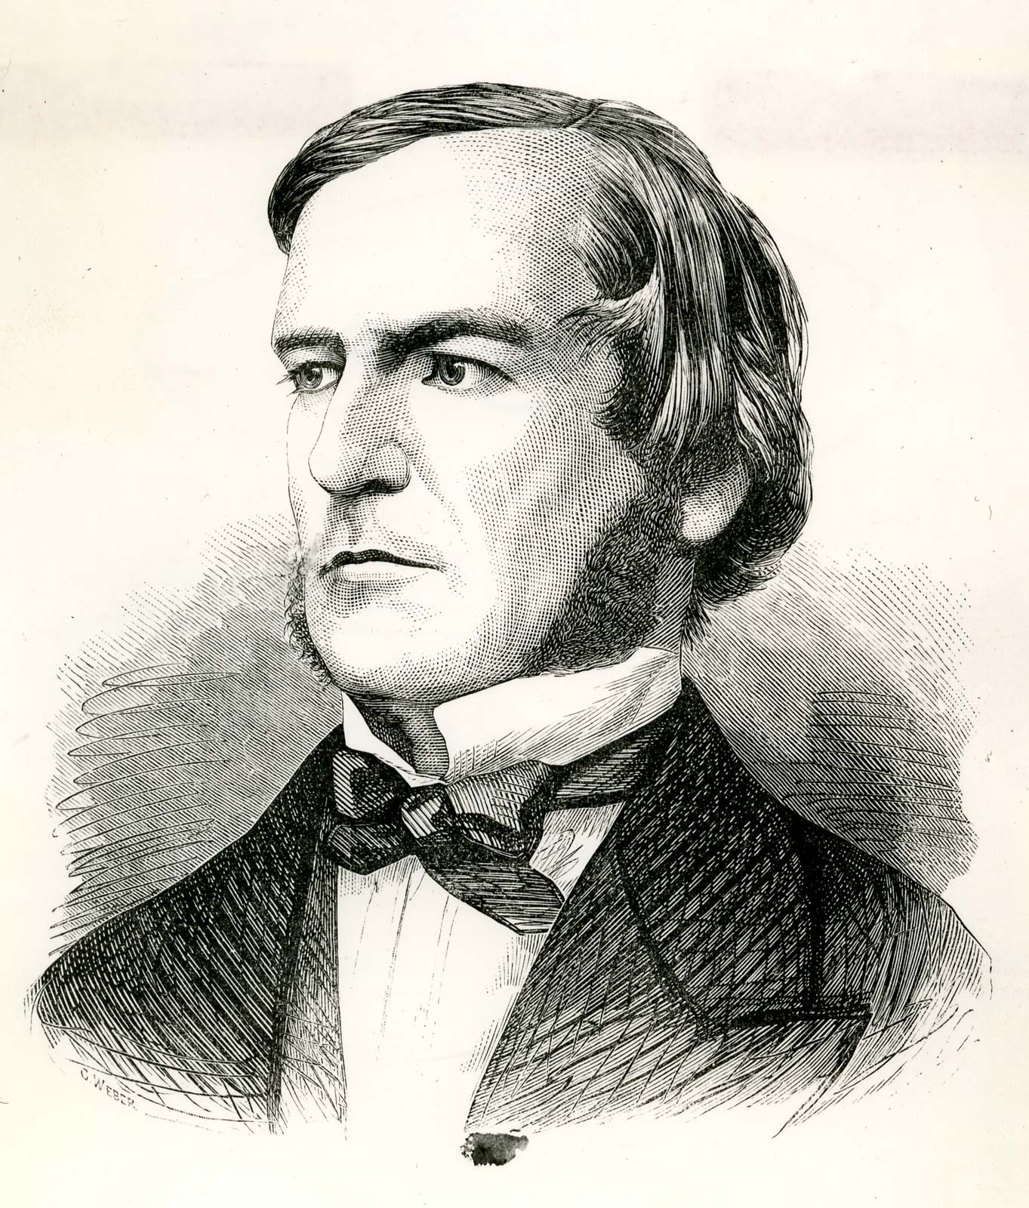
Modern Development : Boole
English mathematician who helped establish modern propositional logic and whose algebra of logic, now called Boolean algebra, is basic to the design of digital computer circuits.
*Poor Family, unlike Leibnitz
Another genius …. who died because of pneumonia, which he caught because he delivered a lecture with wet clothes….

Slide 15
The Basic Unit of Propositional Logic
Proposition!
A proposition refers to the meaning of a claim. So, an argument may have many propositions which are labelled by different letters or numbers (1,2, 3, etc)
Propositional Logic more natural tool for studying validity and truth of proposition than Categorical Logic

Slide 16


EXAMPLE: Prof Farina is a clown and Prof Farina likes little kids
How can symbolise this?
Prof Farina is a clown (proposition 1)
Prof Farina likes little kids (proposition 2)
And (connective, logical operator)
…
We need to introduce all possible connectives

Slide 17













CONNECTIVES
WHAT ARE THE DIFFERENT LOGICAL OPERATORS?*

Slide 18
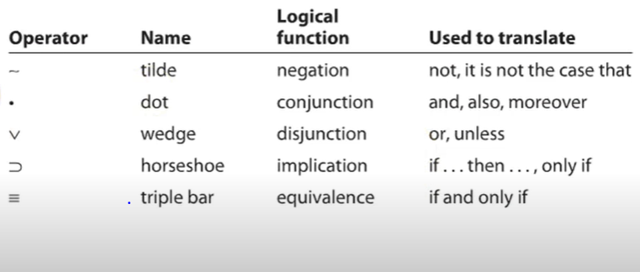









Slide 19
DIFFERENCE BETWEEN SIMPLE STATEMENTS AND COMPOUND STATEMENT?
So, negation can exist and be found in simple statements (statements that have 1 proposition)
Whereas the other 4 logical operators can only exist in compound sentences (that is statements that consist of two or more propositions)
The great thing about propositional logic is precisely that allows us to study the level of truth and validity of complex statements

Slide 20
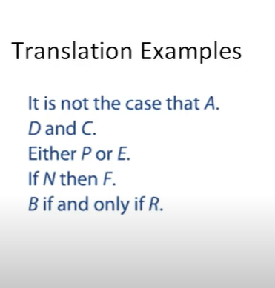



IMPORTANT: Basic way to learn how to use logical operators and build complex statements

Slide 21
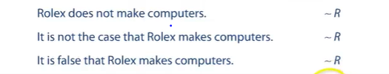


Slide 22






WHAT HAPPENS WHEN THERE ARE TWO CONNECTIVES IN THE SAME STATEMENTS?
George is a clown and doesn’t like to wear hats
It is not the case the George is a clown and he likes hats

Slide 23























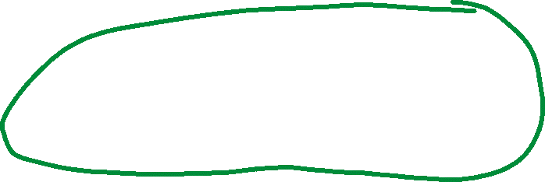






What is the top logic operator?

Slide 24
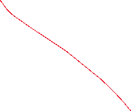



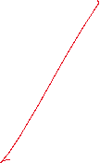






Slide 25


























Slide 26


















Slide 27




















Slide 28
A necessary condition has to be met in order for the consequence to occur but it may not be enough
A sufficient condition is enough for the consequence to occur
If I put gas in my car then I can drive – necessary not sufficient because to drive you need to have a driving license, oil in your car, tyres etc.
See:
https://www.sfu.ca/~swartz/conditions1.htm#:~:text=Examples%208.2%20%2D%20The%20first%20is,%2C%20for%20being%20a%20male.%22&text=%22Winning%20a%20lottery%20is%20a,%2C%20for%20having%20a%20ticket.%22

Slide 29
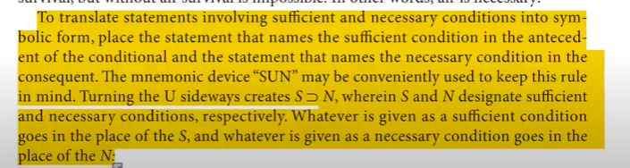







EXAMPLE:
Hilton’s opening a new hotel is a sufficient condition for Marriott’s doing so
Hilton’s opening a new hotel is a necessary condition for Marriott’s doing so

Slide 30
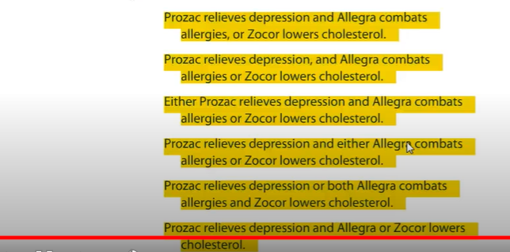




Like in Algebra we need to be careful where we put our parenthesis and brackets

Slide 31











EXERCISES
If MIG changing its logo implies that Sukhoi increases sales, then Antonov will reorganise
If Gazprom and Lukoil lower prices or Rosneft downsizes, then Novatek will expand production

Slide 32














I will not pass this class unless I go to class every day and do all of the homework exercises.
I lock the doors and close the windows whenever I leave to go to work.

Slide 33






Getting up on time and getting ready quickly is sufficient for arriving at work on time.
Practicing an hour a day and getting private lessons twice a week is necessary for playing in the wind ensemble.

Slide 34
WHAT YOU LEARNED TODAY?
Propositional Logic
Historical Antecedents
Modern Development
The Basic Unit of Propositional Logic
Connectives (Logical Operators)
How to Individuate the Top Level Operator
Well formed propositions
Translating propositions into propositional logic
Exercises

